Slide 1
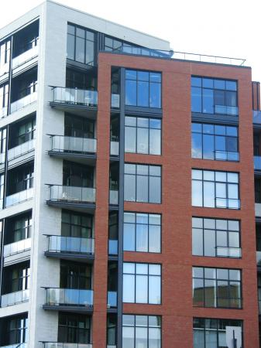
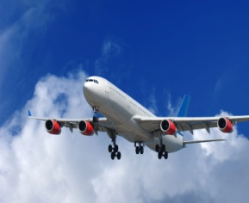

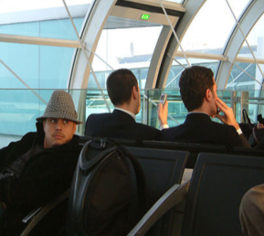
PromoWare Corp.
Hotel Lobby Flight Information
Display System (FIDS)

Slide 2
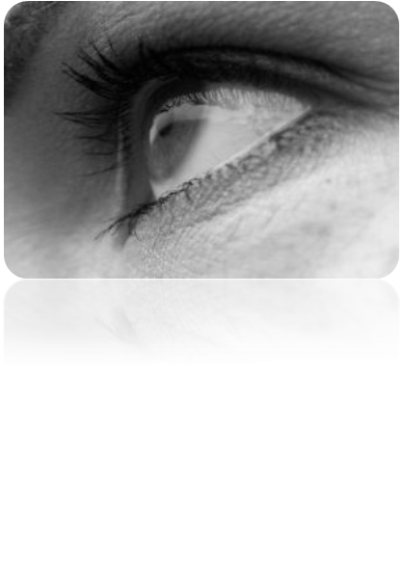
The System
Linked to the airport's flight information system
Banner that shows the hotel is providing the service
Gives your customers live arrival/departure status of their flights up to the moment they depart for the airports
With just a quick look guests can discover the the status of their flights.
Relieves anxiety without the hassle of connecting to the Internet
Hotel staff no longer have to assist guests in retrieving flight information

Slide 3
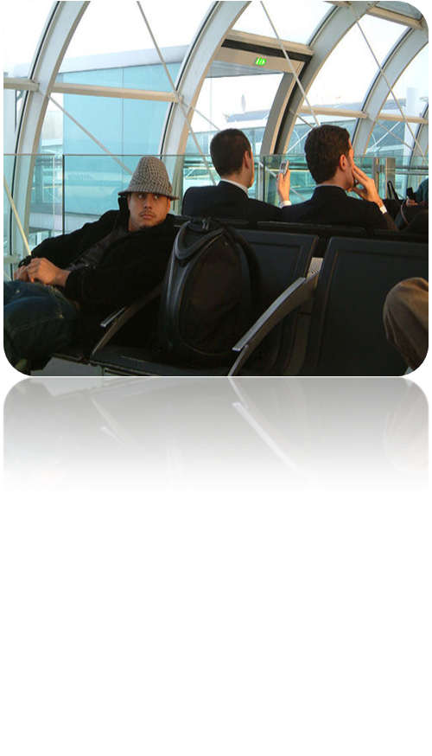
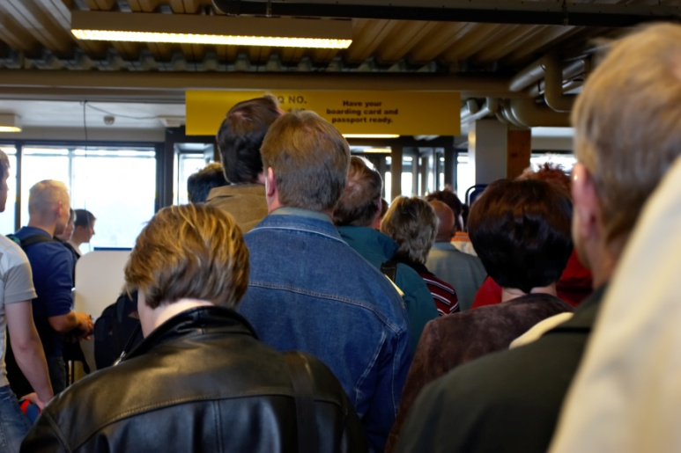
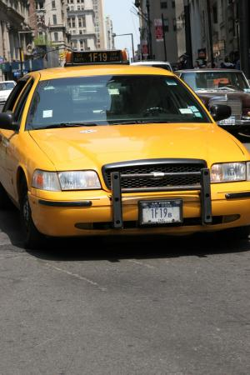
Convenience
Provides added value to your guests by
letting them better plan their departures to the airport.

Slide 4


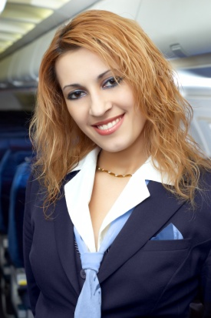
Increased Business
Hotel restaurants and bars benefit from increased business when customers know how long they can stay.
Business travellers can trust the accuracy of their schedules at your property.
Attract airline staff with this trusted service.

Slide 5
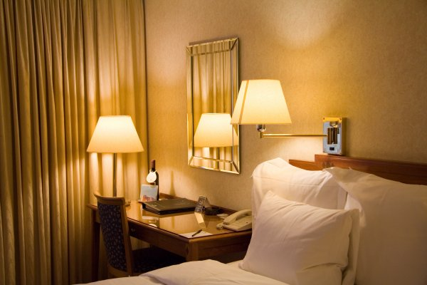
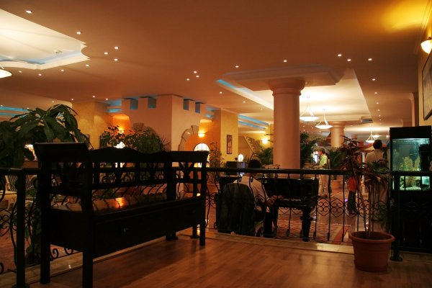
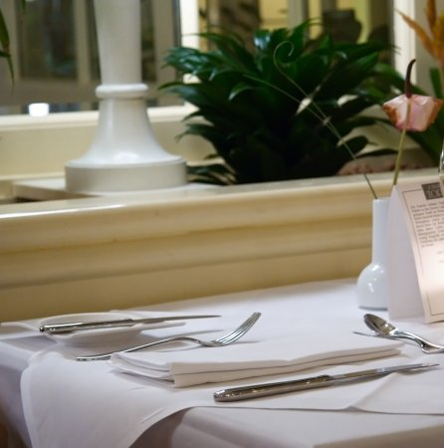
Conferences
Helps hosts predict when attendees will arrive
Presenters can make better decisions about when to proceed, and when to wait
Added value for guests increases your appeal as a conference location

Slide 6
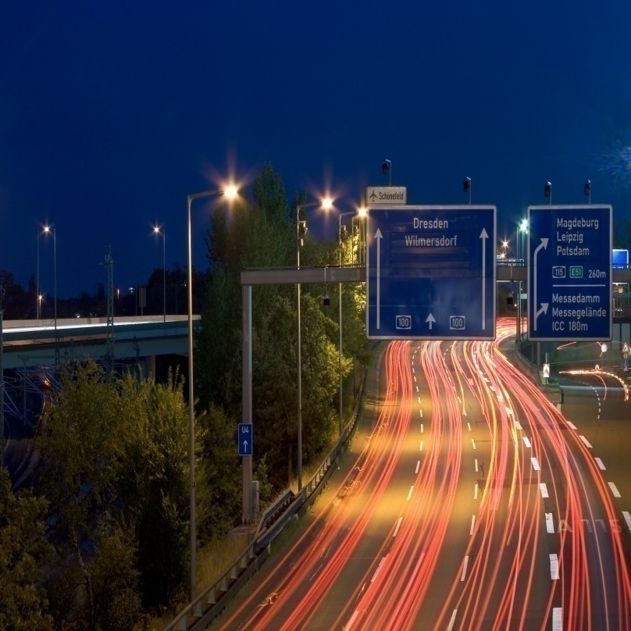
Shuttle Efficiencies
Improves shuttle efficiencies – trips can be anticipated
__________
Reduces costs through more efficient use of labour and resources
___________
Minimizes the time guests need to wait
___________
Less stress for the drivers – better job satisfaction

Slide 7

Check-ins
Front desk staff can prepare check-ins in advance
The time spent completing check-ins is minimized
With fast check-ins, fewer guests are kept waiting in the hotel lobby

Slide 8

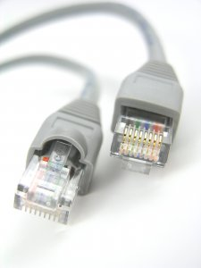
Setting it up...
Optionally packaged with a 19-inch
flat-screen LCD monitor
Easy to install!
Requires only two 110V outlets and an Internet
connection

Slide 9












Who is using the system?
Used in hotels in both North and South America

Slide 10
Testimonials
“We have had wonderful comments about the system, it was a great idea.”
Marla Preston, GM
Hotel Saskatchewan
Regina, SK
“It’s one less thing for me to worry about knowing my flight has been delayed before I give back my key and have to wait in an airport for who knows how long!”
Guest of Regina Inn and Conference Centre
“Feedback has been great so far, especially with the airport being heavily impacted by weather earlier this week.”
Robert Blackwell, GM
Delta Hotel South & Conference Centre
Edmonton, AB

Slide 11
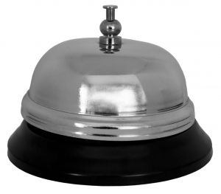
Customer Service
PromoWare takes pride in
being the leader in after-sale
customer relations
24-hour customer service,
seven days per week
The system can be used in
lobbies, restaurants, bars,
and conference centres

Slide 12
Information or
Questions
For more information or a quote, please contact Suzy Huber, Senior Sales Specialist directly at 1-306-717-7079 or by email at shuber@promowarecorp.com
_________
For assistance, contact support staff at
1-800-463-9237
??

